Slide 1
Human following Robot with posture control
2019-3-18
SUSTech · IR

Slide 2
Team Members
王舒心 11611815@sustc.edu.cn
王凯 11612909@sustc.edu.cn
陈闽11612602@sustc.edu.cn
潘天赐11610528@sustc.edu.cn
欧阳奕成11610313@sustc.edu.cn

Slide 3
Outline
01
Background and Motivation
02
Related Work and Novelty of This Work
03
System Setup and Problem Statement
04
Proposed Design and Methods
05
Hardware and Software Platform
06
Goals, Metrics and Timeline

Slide 4
Background and Motivation

Slide 5
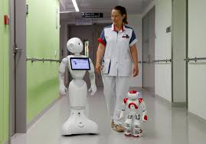
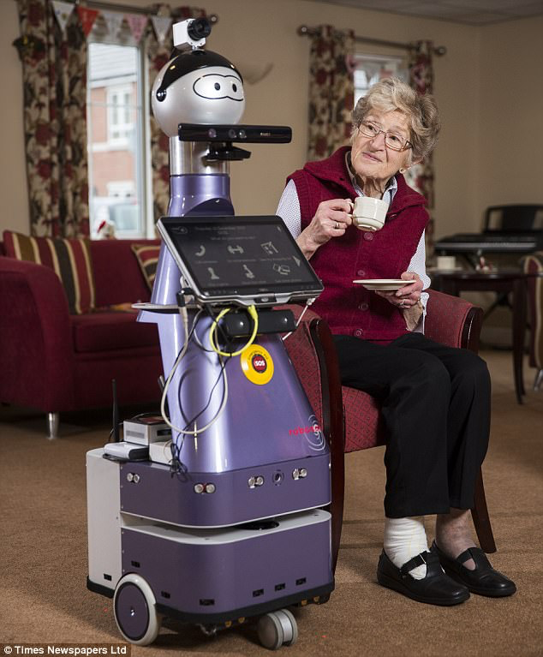
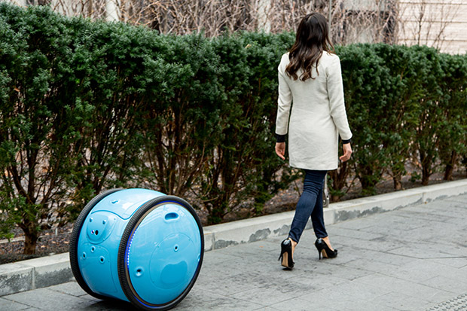
Background and Motivation
User Story
taking care of human in hospitals
helping people during shopping
Elder care
Motivation
Large elder care market and house use robots

Slide 6
Related Work and Novelty of This Work

Slide 7
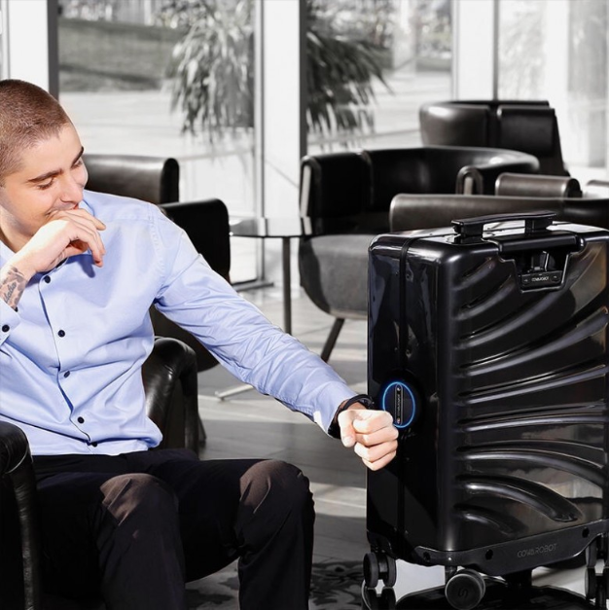
Related Work and Novelty of This Work
Object Detection
Environment Representation
Scene Understanding
Human/pedestrian Detection
Activity Recognition
Semantic Place Classification
Object Modeling etc.

Slide 8
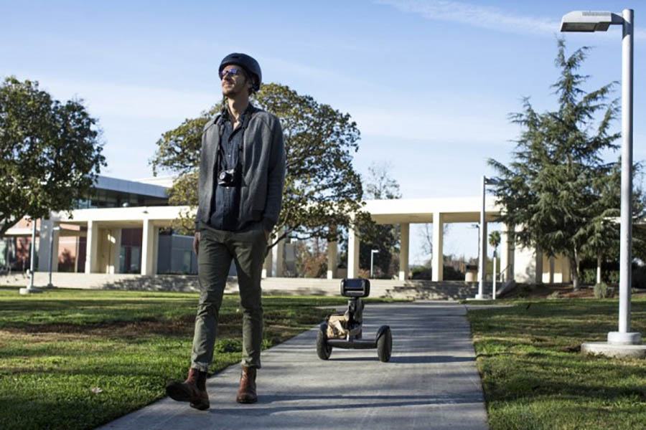
Related Work and Novelty of This Work
perception and control:
Loomo (created by Segway Robotics Team)

Slide 9
System Setup and
Problem Statement

Slide 10
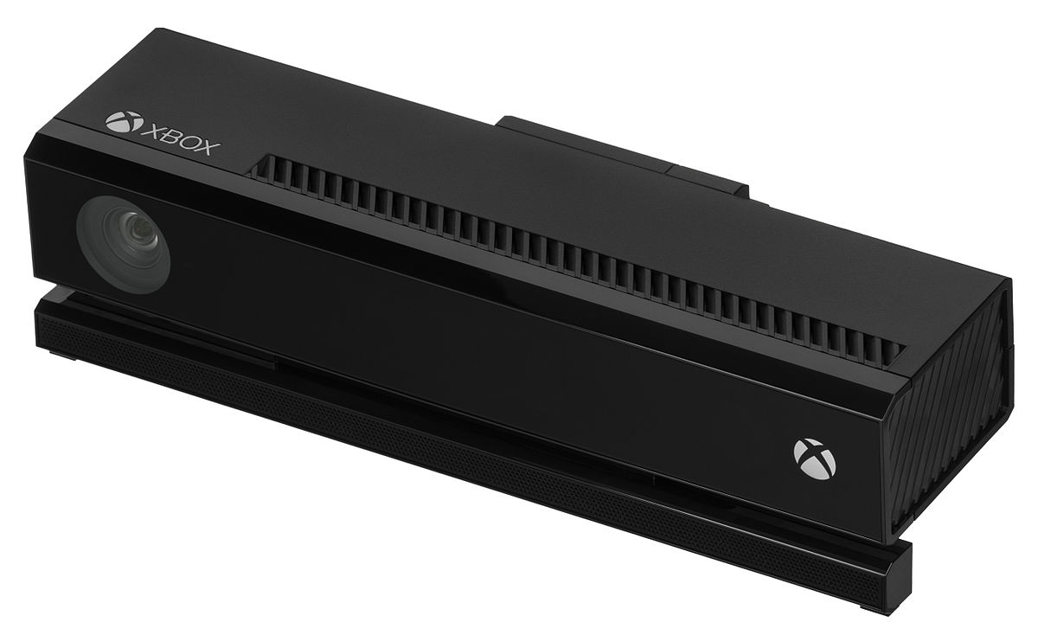
System Setup and Problem Statement
GOAL: To realize a robot that can follow the people and can react to some human postures.
Kinect: a line of motion sensing input device.
To gain the human skeleton data.
To recognize human postures

Slide 11
System Setup and Problem Statement
The problem of our project can be mainly divided into two part:
The robot should follow the people while he/she is walking.
The robot should be able to recognize the skeleton of human in order to recognize people’s posture command.

Slide 12
Proposed Design
and Methods

Slide 13
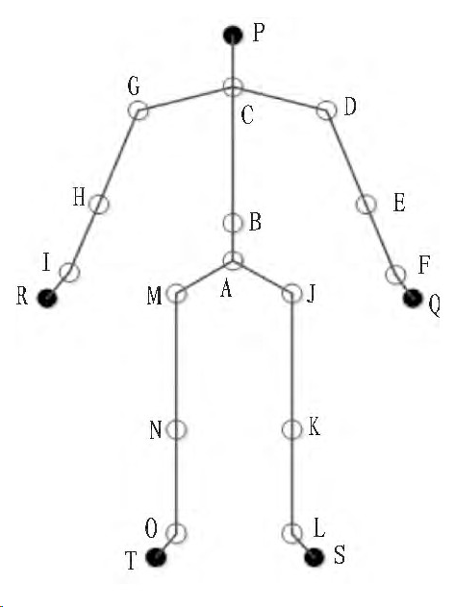
Proposed Design and Methods
Posture Recognition
Posture information
Feature points
Recognize model
logistic regression

Slide 14
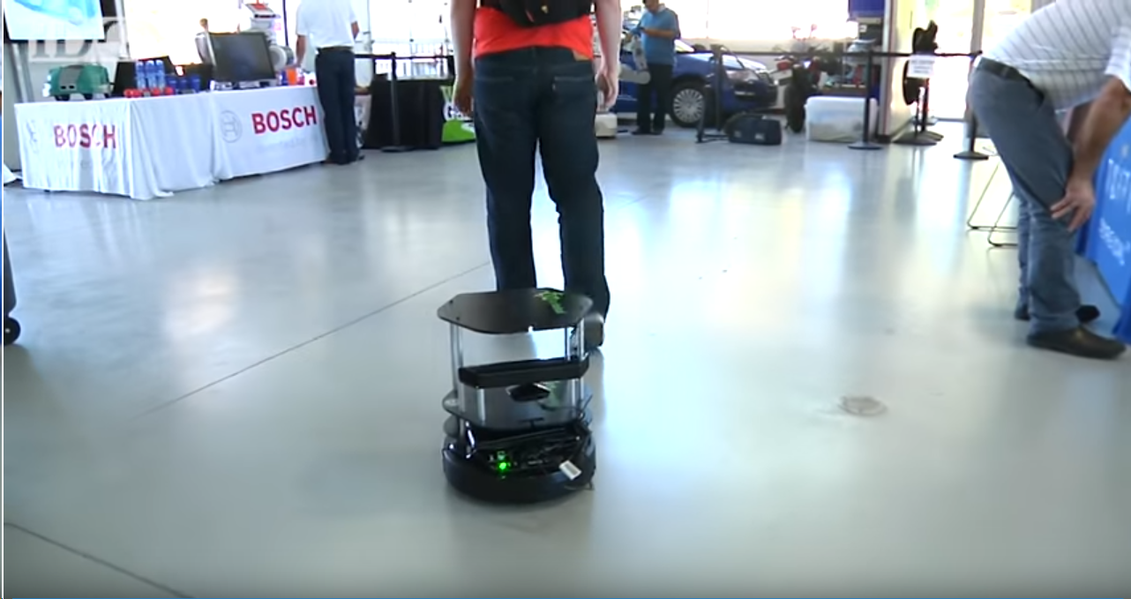
Proposed Design and Methods
Following System
Parallel with posture recognize system
Make bounds checking

Slide 15
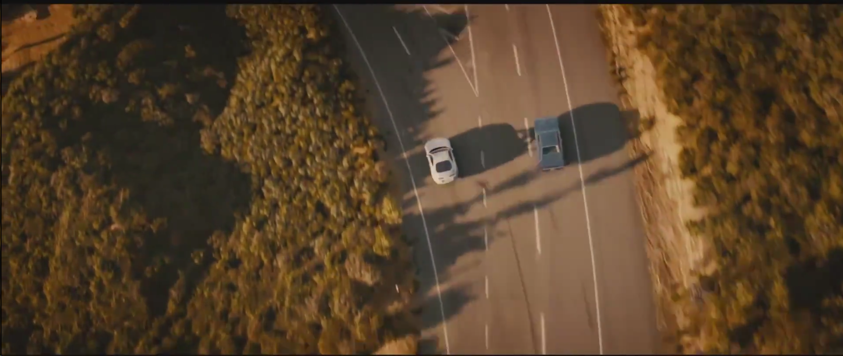
Proposed Design and Methods
Problem need to be solved:
Multiple people in front of camera

Slide 16
Hardware and
Software Platform

Slide 17
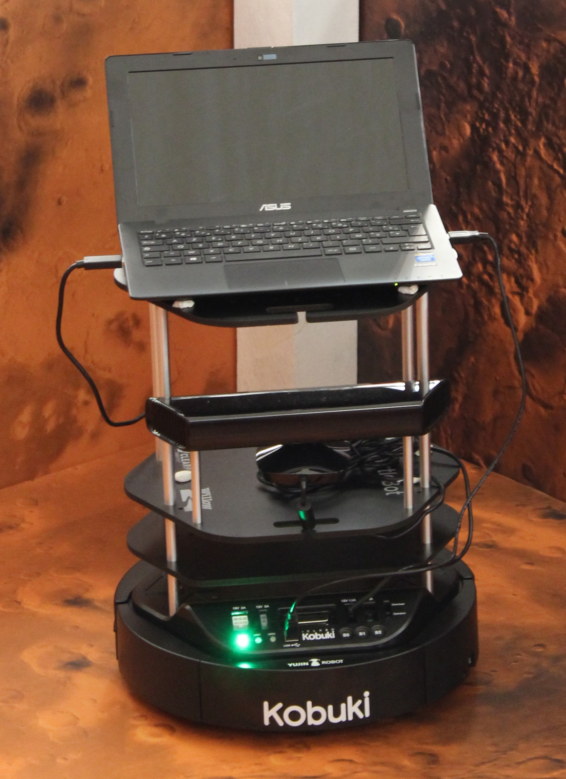
Hardware and Software Platform
Turtlebot2
3D depth camera
Kinect

Slide 18
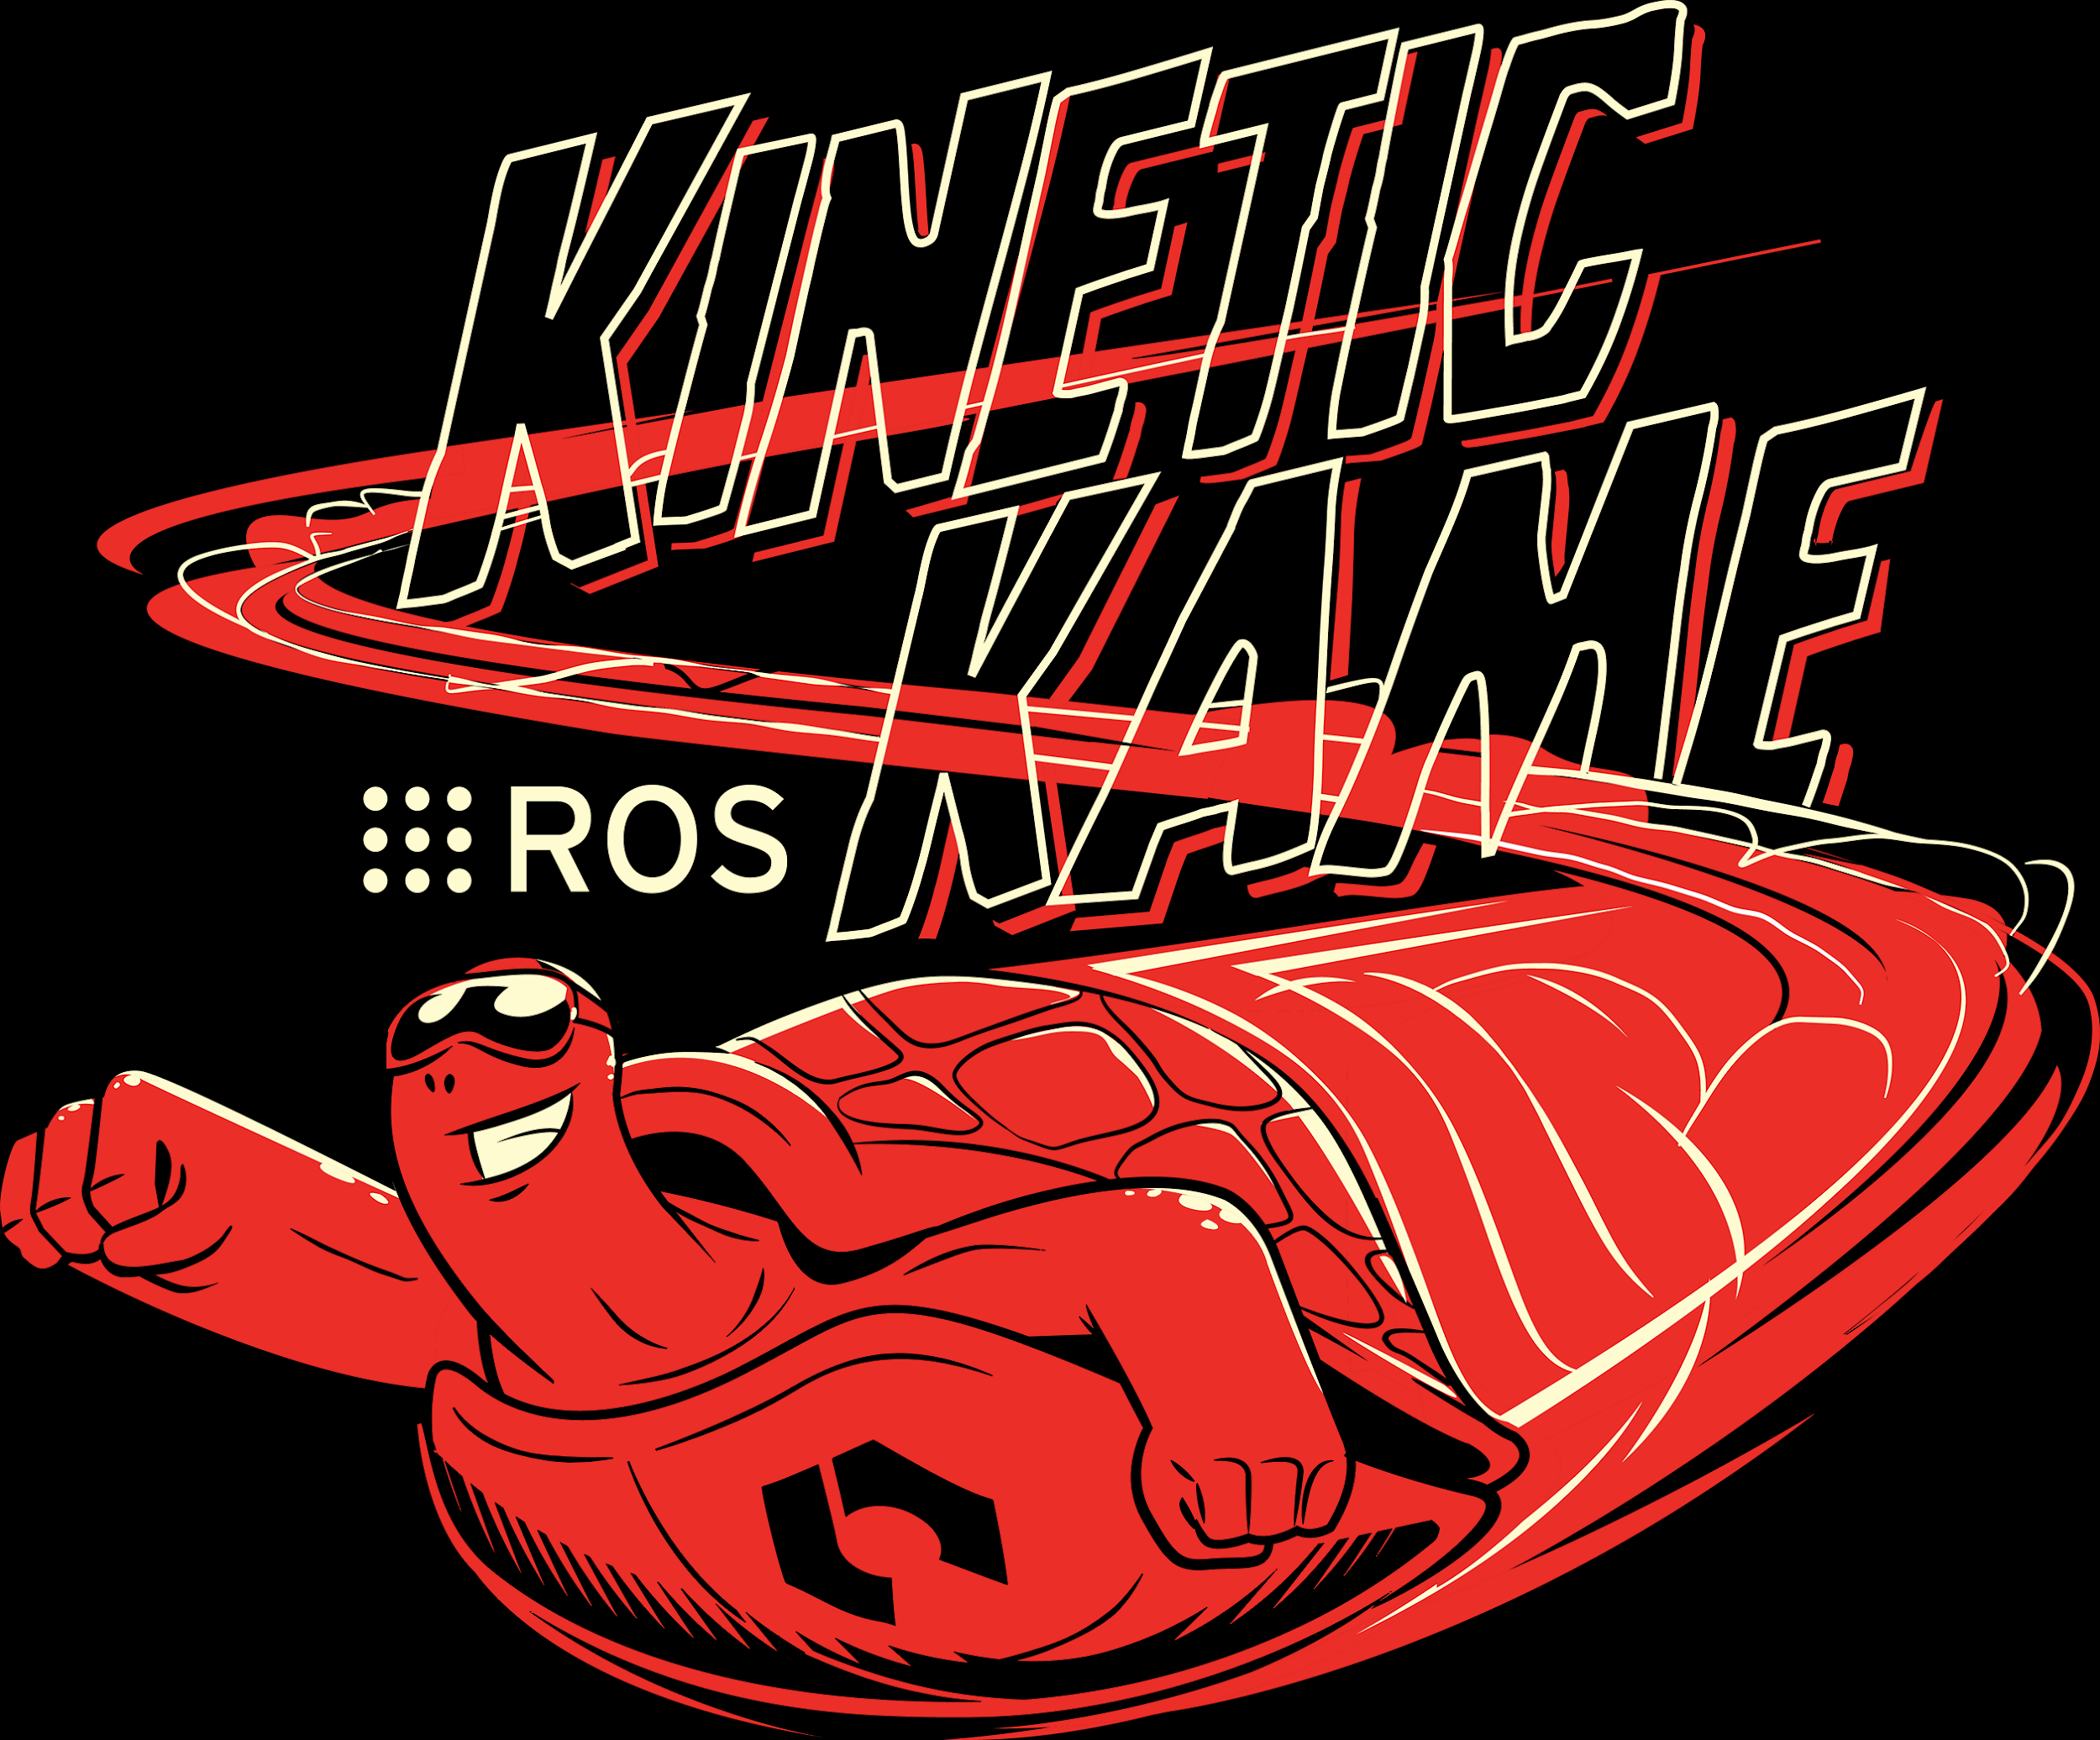
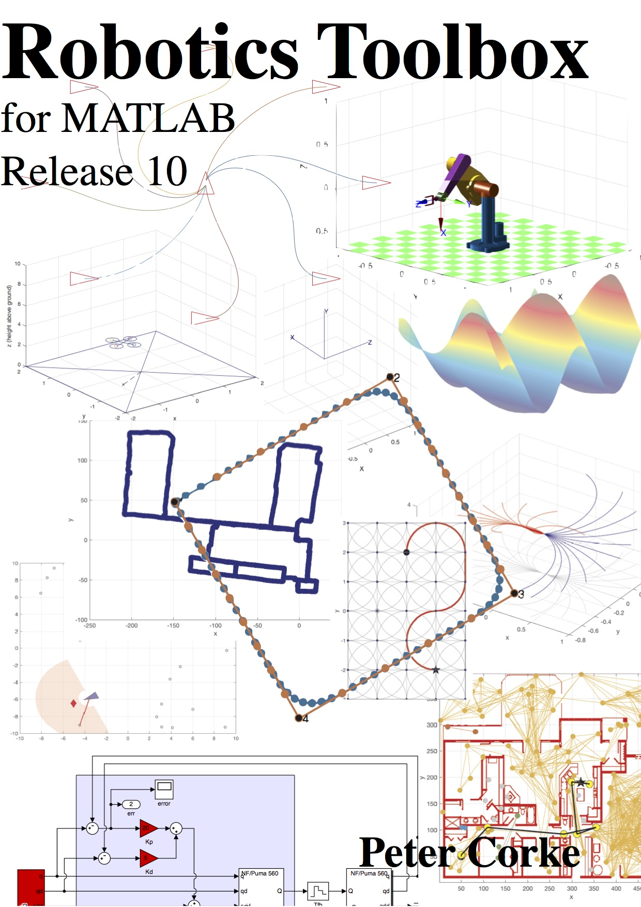
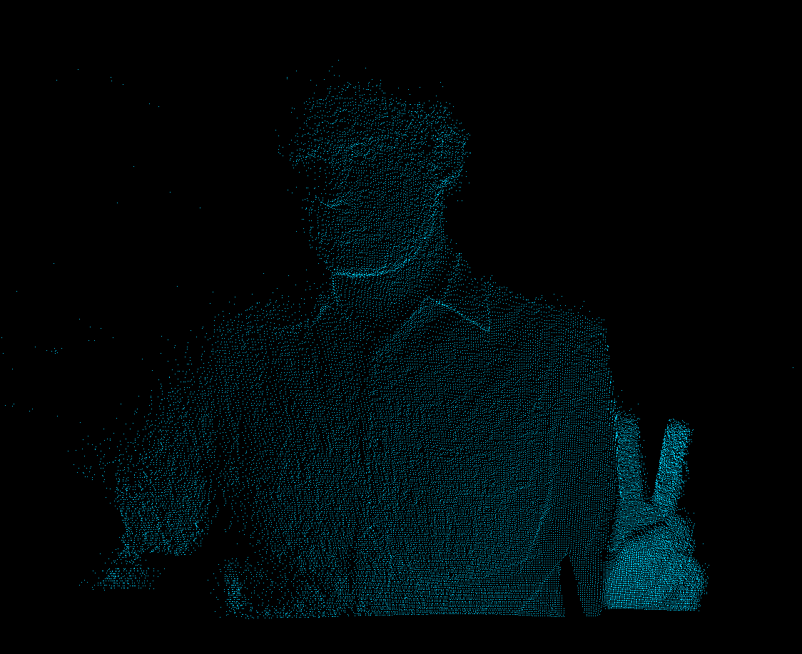
Hardware and Software Platform
ROS Kinetic Kame
MATLAB
Turtlebot_follower

Slide 19
Goals, Metrics and
Timeline

Slide 20
Goals, Metrics and Timeline
Based on the goal we mentioned before, here comes three subtasks.
Robot Vision & Human Skeleton Recognition
Robot Human Tracking
Robot Posture Recognition

Slide 21
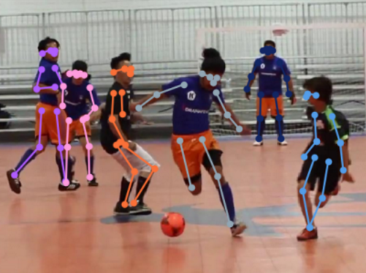
Goals, Metrics and Timeline
Robot Vision & Human Skeleton Recognition
For this task, We need to prove that:
Our robot can get the information of human body.
Our computer can get the signal from the robot.

Slide 22
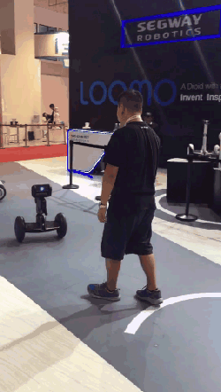
Goals, Metrics and Timeline
Robot Human Tracking
For this task, We need to prove that:
Our robot can first recognize the moving human body by our implementation in Task1.
Our robot can track the human without losing its target.
Robot loomo

Slide 23
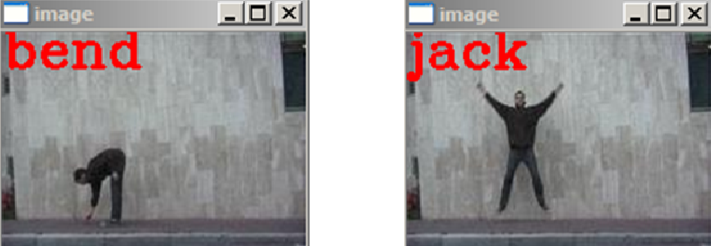
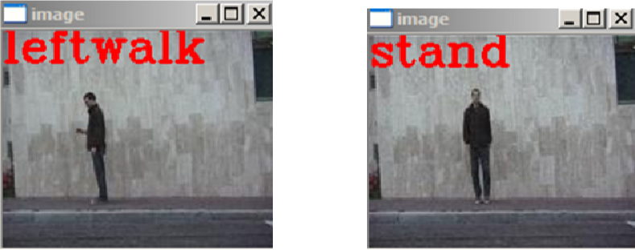
Goals, Metrics and Timeline
Robot Posture Recognition
For this task, We need to prove that:
Our robot can recognize the posture of human.
Our computer can do the right reaction based on the posture it recognized.

Slide 24
Timeline
We will focus more on the first two tasks during the first half semester
And focus on the last task for the next half semester.

Slide 25
Stuff Planning
Chen Min and Pan Tianci ：Subtask1-Robot Vision & Human Skeleton Recognition
Wang Kai and Wang Shuxin ：Subtask2-Robot Human Tracking
Ouyang Yichen ：Subtask3-Robot Posture Recognition

Slide 26
http://davidbuckley.net/DB/HistoryMakers.html
https://ieeexplore.ieee.org/document/6106314
https://www.cnblogs.com/laiy/p/pintos_project1_thread.html
https://github.com/turtlebot/turtlebot_apps/tree/indigo/turtlebot_follower
https://blog.csdn.net/lanhuadechenmo/article/details/58607754
http://bbs.javaee.cc/post/270550_1_1.html
……
Reference

Slide 27
Thank you

